Slide 1
Chapter 8
Digital Design and Computer Architecture, 2nd Edition
David Money Harris and Sarah L. Harris

Slide 2
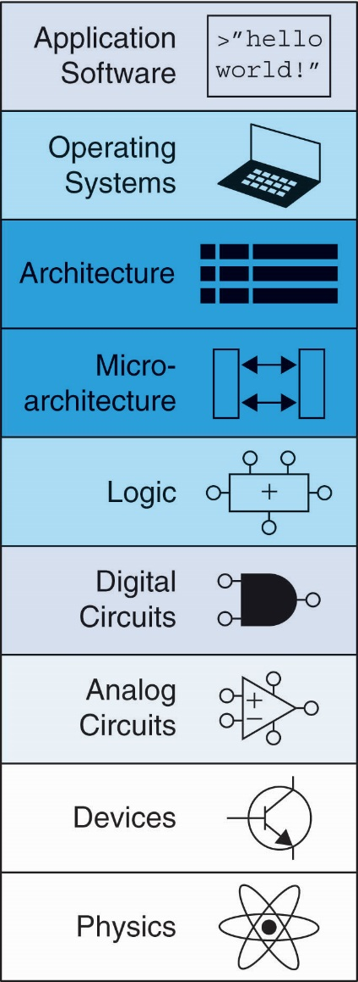
Chapter 8 :: Topics
Introduction
Memory System Performance Analysis
Caches
Virtual Memory
Memory-Mapped I/O
Summary

Slide 3
Introduction
Computer performance depends on:
Processor performance
Memory system performance
Memory Interface

Slide 4
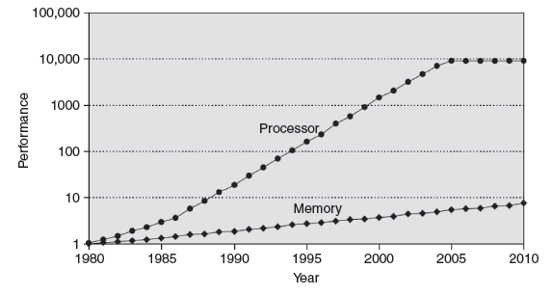
Processor-Memory Gap
In prior chapters, assumed access memory in 1 clock cycle – but hasn’t been true since the 1980’s

Slide 5
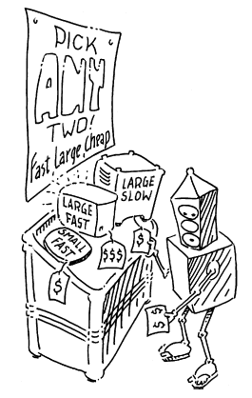
Memory System Challenge
Make memory system appear as fast as processor
Use hierarchy of memories
Ideal memory:
Fast
Cheap (inexpensive)
Large (capacity)
But can only choose two!

Slide 6
Memory Hierarchy

Slide 7
Locality
Exploit locality to make memory accesses fast
Temporal Locality:
Locality in time
If data used recently, likely to use it again soon
How to exploit: keep recently accessed data in higher levels of memory hierarchy
Spatial Locality:
Locality in space
If data used recently, likely to use nearby data soon
How to exploit: when access data, bring nearby data into higher levels of memory hierarchy too

Slide 8
Memory Performance
Hit: data found in that level of memory hierarchy
Miss: data not found (must go to next level)
Hit Rate = # hits / # memory accesses
= 1 – Miss Rate
Miss Rate = # misses / # memory accesses
= 1 – Hit Rate
Average memory access time (AMAT): average time for processor to access data
AMAT = t_{cache} + MR_{cache}[t_{MM} + MR_{MM}(t_{VM})]

Slide 9
Memory Performance Example 1
A program has 2,000 loads and stores
1,250 of these data values in cache
Rest supplied by other levels of memory hierarchy
What are the hit and miss rates for the cache?

Slide 10
Memory Performance Example 1
A program has 2,000 loads and stores
1,250 of these data values in cache
Rest supplied by other levels of memory hierarchy
What are the hit and miss rates for the cache?
Hit Rate = 1250/2000 = 0.625
Miss Rate = 750/2000 = 0.375 = 1 – Hit Rate

Slide 11
Memory Performance Example 2
Suppose processor has 2 levels of hierarchy: cache and main memory
t_{cache} = 1 cycle, t_{MM} = 100 cycles
What is the AMAT of the program from Example 1?

Slide 12
Memory Performance Example 2
Suppose processor has 2 levels of hierarchy: cache and main memory
t_{cache} = 1 cycle, t_{MM} = 100 cycles
What is the AMAT of the program from Example 1?
AMAT = t_{cache} + MR_{cache}(t_{MM})
= [1 + 0.375(100)] cycles
= 38.5 cycles

Slide 13
Gene Amdahl, 1922-
Amdahl’s Law: the effort spent increasing the performance of a subsystem is wasted unless the subsystem affects a large percentage of overall performance
Co-founded 3 companies, including one called Amdahl Corporation in 1970

Slide 14
Cache
Highest level in memory hierarchy
Fast (typically ~ 1 cycle access time)
Ideally supplies most data to processor
Usually holds most recently accessed data

Slide 15
Cache Design Questions
What data is held in the cache?
How is data found?
What data is replaced?
Focus on data loads, but stores follow same principles

Slide 16
What data is held in the cache?
Ideally, cache anticipates needed data and puts it in cache
But impossible to predict future
Use past to predict future – temporal and spatial locality:
Temporal locality: copy newly accessed data into cache
Spatial locality: copy neighboring data into cache too

Slide 17
Cache Terminology
Capacity (C):
number of data bytes in cache
Block size (b):
bytes of data brought into cache at once
Number of blocks (B = C/b):
number of blocks in cache: B = C/b
Degree of associativity (N):
number of blocks in a set
Number of sets (S = B/N):
each memory address maps to exactly one cache set

Slide 18
How is data found?
Cache organized into S sets
Each memory address maps to exactly one set
Caches categorized by # of blocks in a set:
Direct mapped: 1 block per set
N-way set associative: N blocks per set
Fully associative: all cache blocks in 1 set
Examine each organization for a cache with:
Capacity (C = 8 words)
Block size (b = 1 word)
So, number of blocks (B = 8)

Slide 19
Example Cache Parameters
C = 8 words (capacity)
b = 1 word (block size)
So, B = 8 (# of blocks)
Ridiculously small, but will illustrate organizations

Slide 20
Direct Mapped Cache

Slide 21
Direct Mapped Cache Hardware

Slide 22
Direct Mapped Cache Performance
# MIPS assembly code
addi $t0, $0, 5
loop: beq $t0, $0, done
lw $t1, 0x4($0)
lw $t2, 0xC($0)
lw $t3, 0x8($0)
addi $t0, $t0, -1
j loop
done:
Miss Rate = ?

Slide 23
Direct Mapped Cache Performance
# MIPS assembly code
addi $t0, $0, 5
loop: beq $t0, $0, done
lw $t1, 0x4($0)
lw $t2, 0xC($0)
lw $t3, 0x8($0)
addi $t0, $t0, -1
j loop
done:
Miss Rate = 3/15
= 20%
Temporal Locality
Compulsory Misses

Slide 24
Direct Mapped Cache: Conflict
# MIPS assembly code
addi $t0, $0, 5
loop: beq $t0, $0, done
lw $t1, 0x4($0)
lw $t2, 0x24($0)
addi $t0, $t0, -1
j loop
done:
Miss Rate = ?

Slide 25
Direct Mapped Cache: Conflict
# MIPS assembly code
addi $t0, $0, 5
loop: beq $t0, $0, done
lw $t1, 0x4($0)
lw $t2, 0x24($0)
addi $t0, $t0, -1
j loop
done:
Miss Rate = 10/10
= 100%
Conflict Misses

Slide 26
N-Way Set Associative Cache

Slide 27
N-Way Set Associative Performance
# MIPS assembly code
addi $t0, $0, 5
loop: beq $t0, $0, done
lw $t1, 0x4($0)
lw $t2, 0x24($0)
addi $t0, $t0, -1
j loop
done:
Miss Rate = ?

Slide 28
N-Way Set Associative Performance
# MIPS assembly code
addi $t0, $0, 5
loop: beq $t0, $0, done
lw $t1, 0x4($0)
lw $t2, 0x24($0)
addi $t0, $t0, -1
j loop
done:
Miss Rate = 2/10
= 20%
Associativity reduces
conflict misses

Slide 29
Fully Associative Cache
Reduces conflict misses
Expensive to build

Slide 30
Spatial Locality?
Increase block size:
Block size, b = 4 words
C = 8 words
Direct mapped (1 block per set)
Number of blocks, B = 2 (C/b = 8/4 = 2)

Slide 31
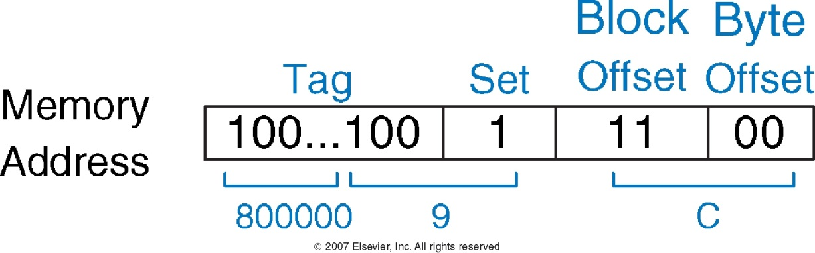
Cache with Larger Block Size

Slide 32
Direct Mapped Cache Performance
addi $t0, $0, 5
loop: beq $t0, $0, done
lw $t1, 0x4($0)
lw $t2, 0xC($0)
lw $t3, 0x8($0)
addi $t0, $t0, -1
j loop
done:
Miss Rate = ?

Slide 33
Direct Mapped Cache Performance
addi $t0, $0, 5
loop: beq $t0, $0, done
lw $t1, 0x4($0)
lw $t2, 0xC($0)
lw $t3, 0x8($0)
addi $t0, $t0, -1
j loop
done:
Miss Rate = 1/15
= 6.67%
Larger blocks
reduce compulsory misses
through spatial locality

Slide 34
Cache Organization Recap
Capacity: C
Block size: b
Number of blocks in cache: B = C/b
Number of blocks in a set: N
Number of sets: S = B/N
Organization | Number of Ways (N) | Number of Sets (S = B/N)
Direct Mapped | 1 | B
N-Way Set Associative | 1 < N < B | B / N
Fully Associative | B | 1

Slide 35
Capacity Misses
Cache is too small to hold all data of interest at once
If cache full: program accesses data X & evicts data Y
Capacity miss when access Y again
How to choose Y to minimize chance of needing it again?
Least recently used (LRU) replacement: the least recently used block in a set evicted

Slide 36
Types of Misses
Compulsory: first time data accessed
Capacity: cache too small to hold all data of interest
Conflict: data of interest maps to same location in cache
Miss penalty: time it takes to retrieve a block from lower level of hierarchy

Slide 37
LRU Replacement
# MIPS assembly
lw $t0, 0x04($0)
lw $t1, 0x24($0)
lw $t2, 0x54($0)

Slide 38
LRU Replacement
# MIPS assembly
lw $t0, 0x04($0)
lw $t1, 0x24($0)
lw $t2, 0x54($0)

Slide 39
Cache Summary
What data is held in the cache?
Recently used data (temporal locality)
Nearby data (spatial locality)
How is data found?
Set is determined by address of data
Word within block also determined by address
In associative caches, data could be in one of several ways
What data is replaced?
Least-recently used way in the set

Slide 40
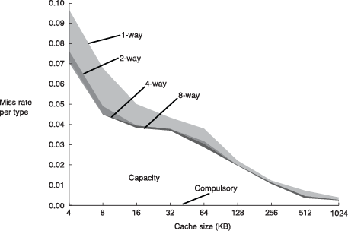
Miss Rate Trends
Bigger caches reduce capacity misses
Greater associativity reduces conflict misses
Adapted from Patterson & Hennessy, Computer Architecture: A Quantitative Approach, 2011

Slide 41
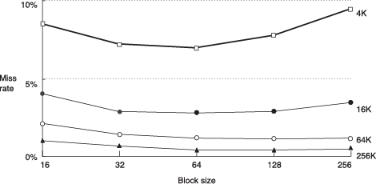
Miss Rate Trends
Bigger blocks reduce compulsory misses
Bigger blocks increase conflict misses

Slide 42
Multilevel Caches
Larger caches have lower miss rates, longer access times
Expand memory hierarchy to multiple levels of caches
Level 1: small and fast (e.g. 16 KB, 1 cycle)
Level 2: larger and slower (e.g. 256 KB, 2-6 cycles)
Most modern PCs have L1, L2, and L3 cache

Slide 43
Intel Pentium III Die

